Slide 1


Sensor Spoofing and Data Manipulation Risks
How attackers could manipulate environmental or equipment data

Slide 2
Sensor Spoofing and Data Manipulation Risks
Sensor Spoofing: An Introduction
When Data Lies, Decisions Fail
Sensors collect real-world data that machines and operators rely on to make critical decisions
When that data is falsified, systems respond to conditions that do not actually exist
Spoofing means feeding false inputs
Attackers can manipulate temperature, pressure, flow, or location readings without touching physical equipment
The consequences range from minor inefficiencies to catastrophic equipment failure or safety incidents

Slide 3
Sensor Spoofing and Data Manipulation Risks
How Sensor Spoofing Works
The mechanics of deception
Attackers intercept or replace legitimate sensor communications
False data is injected between sensors and control systems
Systems trust incoming data without verifying its authenticity
Automated responses trigger based on fabricated readings
No physical access to equipment required—attacks happen through data streams

Slide 4

Sensor Spoofing and Data Manipulation Risks
Critical Infrastructure Attacks
When spoofing targets essential services
Power grid sensors manipulated to hide system overloads
Water treatment readings spoofed to mask contamination
Nuclear facility centrifuges destroyed by Stuxnet malware
Industrial control systems fed false temperature and pressure data
Operators made decisions based on completely fabricated information

Slide 5

Sensor Spoofing and Data Manipulation Risks
Transportation and Navigation Spoofing
Misdirecting vehicles and vessels
GPS spoofing redirected military drones and commercial ships
Tesla autopilot confused by simple stickers on road markings
Aircraft navigation systems tricked with false position data
Shipping vessels pushed off course in busy waterways
Low-cost equipment can disrupt high-value navigation systems

Slide 6
Sensor Spoofing and Data Manipulation Risks
Healthcare Device Manipulation
Life-critical systems under attack
Insulin pumps hacked remotely to deliver wrong dosages
Medical monitors spoofed to hide cardiac events in lab tests
Patient vital signs falsified to mask deteriorating conditions
Drug delivery systems manipulated to alter medication timing
Wireless medical devices particularly vulnerable to interference

Slide 7
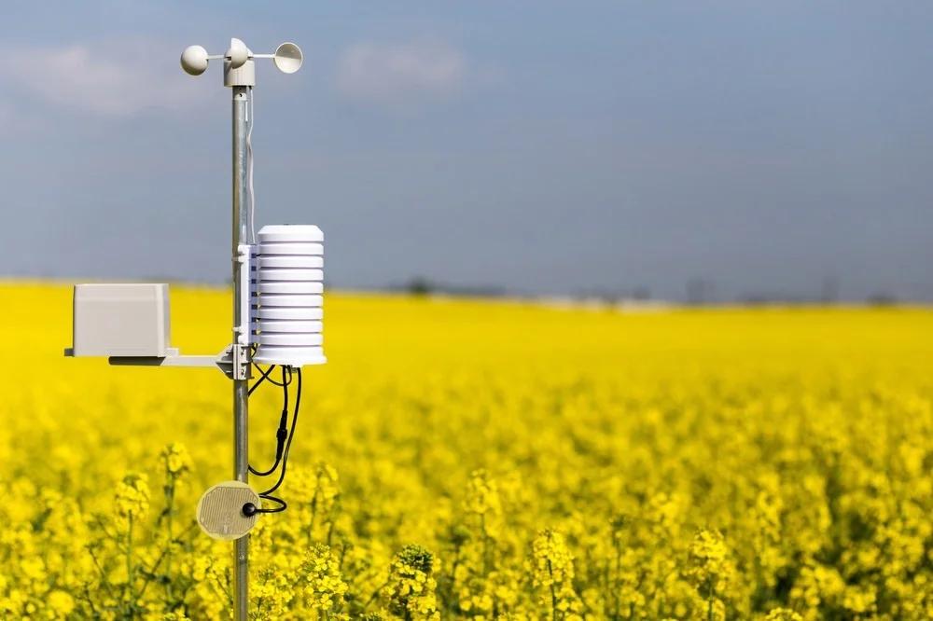
Sensor Spoofing and Data Manipulation Risks
Environmental and Agricultural Threats
Spoofing in outdoor operations
Weather monitoring systems fed false climate data
Soil moisture sensors manipulated to trigger incorrect irrigation
Air quality monitors spoofed to hide pollution levels
Equipment tracking systems given false location information
Resource extraction operations misled about environmental conditions

Slide 8
Sensor Spoofing and Data Manipulation Risks
Consequences of Successful Attacks
Equipment damage from operating outside safe parameters
Safety incidents when protective systems are bypassed
Financial losses from poor operational decisions
Environmental harm from undetected contamination
Loss of public trust when critical systems fail
Real-world impact when spoofing succeeds

Slide 9

Sensor Spoofing and Data Manipulation Risks
Protective Measures and Response
Verify readings from multiple independent sources
Implement data validation checks and range limits
Monitor for sudden or unexplained changes in sensor data
Use encrypted communications between sensors and systems
Defending against sensor spoofing
Report anomalies immediately to security teams

